Slide 1
The Network Layer lec 20-4 Hierarchical Routing
School of Software Engineering
South China University of Technology
Dr. Chunhua Chen
chunhuachen@scut.edu.cn
2020 Spring

Slide 2
Hierarchical Routing
The LS and DV algorithms we have studied are not only widely used in practice, they are essentially the only routing algorithms used in practice today in the Internet.
More about the network of routers:
Scale: hundreds of millions of routers
Administrative autonomy:
Autonomous Systems (ASs): intra-autonomous system routing protocol.
Each AS consisting of a group of routers that are typically under the same administrative control
Routers within the same AS all run the same routing algorithm and have information about each other
Connect to other AS by gateway routers

Slide 3
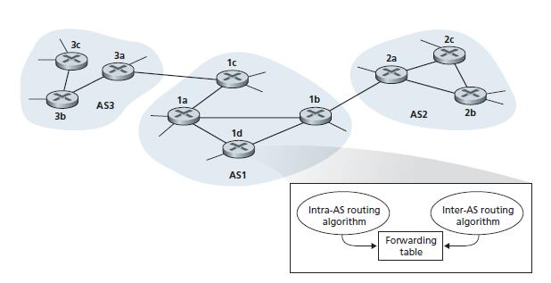

gateway routers
The routers in an AS determine routing paths for source-destination pairs that are internal to the AS.
How does a router, within some AS, know how to route a packet to a destination that is outside the AS?

Slide 4
The inter-AS routing protocol
Obtaining reachability information from neighboring ASs and propagating the reachability information to all routers internal to the AS.
Since the inter-AS routing protocol involves communication between two ASs, the two communicating ASs must run the same inter-AS routing protocol.
In fact, in the Internet all ASs run the same inter-AS routing protocol, called BGP4.

Slide 5
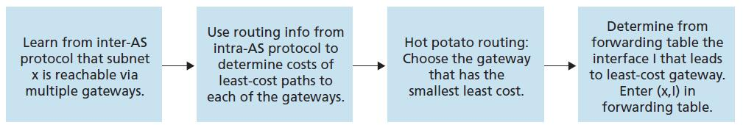
Hot-Potato Routing.

